Slide 1
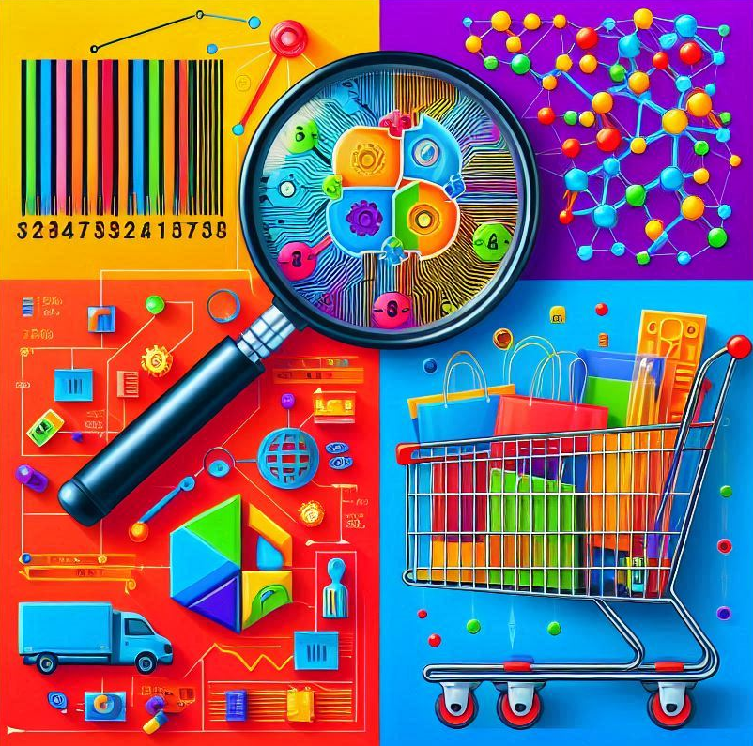
Store Segmentation Using Machine Learning

Slide 2

Agenda Store segmentation using machine learning
Conducting the following tasks for store segmentation
Data Collection
Exploratory data analysis
Data Cleaning
Running k-means clustering for store segmentation
Formulating targeted engagement and assortment strategies for different demographics of stores to maximize customer satisfaction and drive sales growth

Slide 3
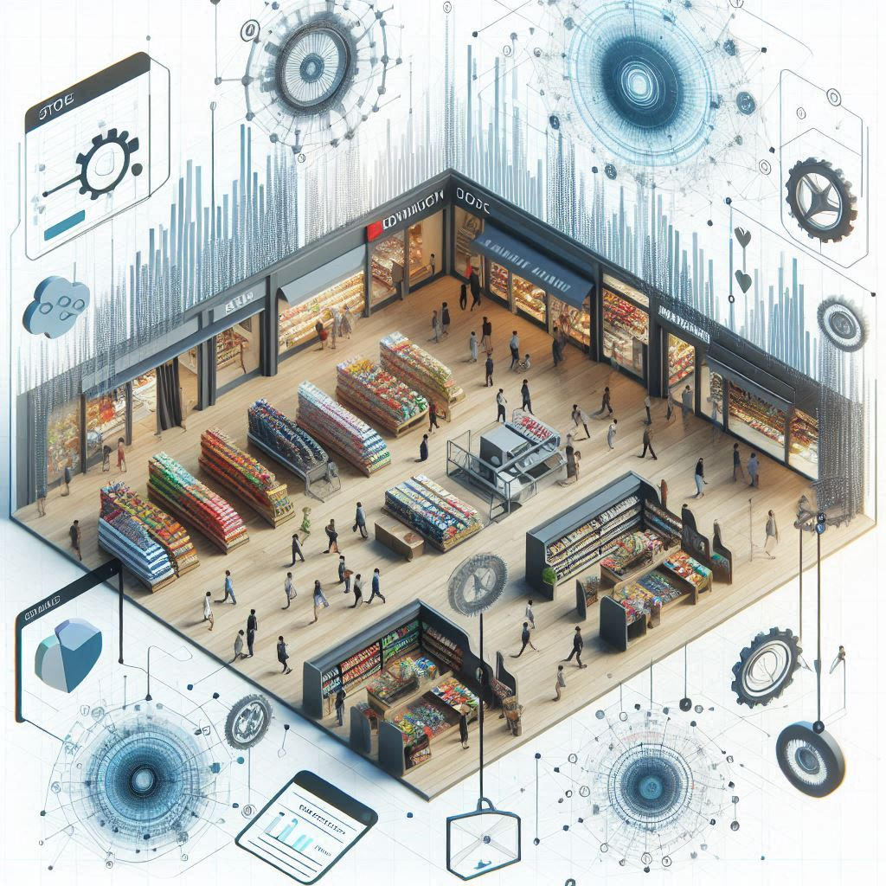
Table of contents Store segmentation using machine learning
Overview and key benefits of store segmentation
Analyzing current store segmentation method
How machine learning can solve store segmentation issues
Store segmentation using machine learning
ML process overview
Types of data for segmentation
Overview of data cleaning techniques
K-means clustering for store segmentation
Identifying ideal number of clusters
Overview of determining optimum clusters
Analyzing clusters characteristics
Formulating marketing and pricing strategies for different clusters

Slide 4
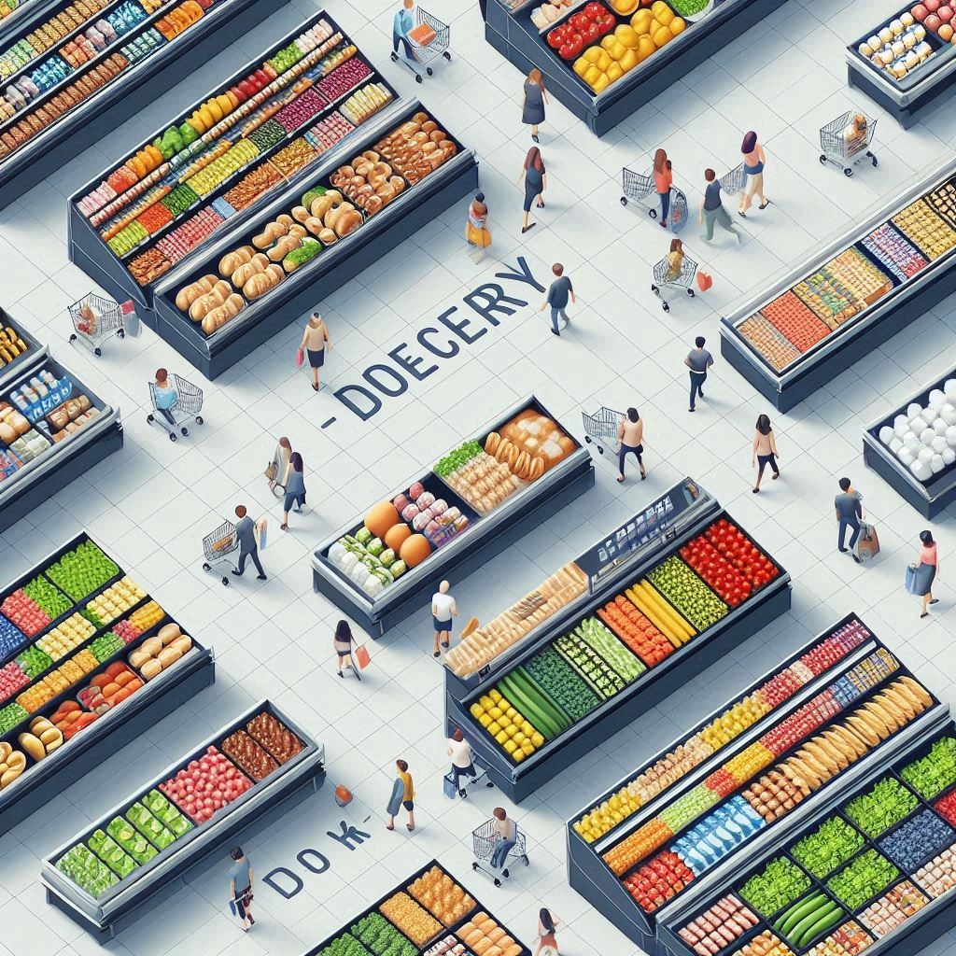
Overview and key benefits of store segmentation
Process to segment customers based on common characteristics such as demographics, geographic etc.
Segmentation goal is to understand the needs and preferences of the stores along with customers.
Benefits of store segmentation is to improve inventory management and stock optimization.
Improves the customer targeting and personalized marketing.
Increased customer satisfaction and loyalty.
Efficient spending of marketing budgets.

Slide 5

Types of store segmentation
Geographic Segmentation: Segmenting stores based on location.
Demographic Segmentation: Segmenting based on customer demographics.
Behavioral Segmentation: Based on shopping behavior and patterns.
Psychographic Segmentation: Based on lifestyle and personality traits.

Slide 6
Issues with current store segmentation method
Current method used for customer segmentation
Recency
Frequency
Monetary Value (RFM) analysis
Static Segmentation
Homogeneity
Equal weightage
Unable to capture changes in customer preferences due to reliance on past transactional data
Lack of customer preferences and behaviors understanding lead to homogeneity within segments
Equal variable weightage might not capture underlying drivers of customer behavior

Slide 7

How machine learning can solve store segmentation issues
Problems with traditional method
How ML can solve these problems
Mitigate the influence of outliers on customer segmentation results
Sensitivity to outliers
Weightage based on importance of relevance to the segmentation task
Variable weighting
Identification of subgroups and clusters within the segments
Limited prediction accuracy

Slide 8




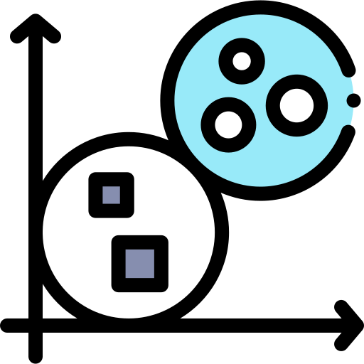

Machine Learning process for Store segmentation
Data Collection
Exploratory
data analysis
Run k-means clustering for store segmentation
Data Cleaning
Determine ideal number of cluster
Analyze results

Slide 9
Types of data for segmentation
Variable | Data Type | Range | Description
StoreNum | Numerical | Integer | Unique identification of stores
State Province | Categorical | Integer
Market | Categorical | Integer
Region | Categorical | Integer
Locality Code | Categorical | (1,2,3)
Climate Code | Categorical | (1,2,3) | 1- Cold, 2- Moderate, 3-Warm
Pharmacy_IND | Categorical | (N,Y) | Pharmacy Inside Store
Pickup_IND | Categorical | (N,Y) | Is Store open for Pick ups/Returns
SFS_IND | Categorical | (N,Y) | Does Store ship ECOM Orders from Store
COMP_IND | Categorical | (N,Y) | Is there a Competitor Store in 5 mile radius of store
College_STORE_IND | Categorical | (N,Y) | College Neighborhood Store
INCOME_CD | Categorical | (1,2,3) | 1- Low, 2- Medium, 3- High
ETHNICITY_CD | Categorical | (1,2,3) | 1- Asian 2- White 3-Hispanic

Slide 10
Types of data for segmentation
Variable | Data Type | Range | Description
Year-Week | Numerical | Integer | Unique identification of stores
Category | Categorical | Integer
Sales | Categorical | Integer
Units | Categorical | Integer
Profit | Categorical | (1,2,3)
The data is segregated in to parts:
Store Sales Data
Store Hierarchy Data
Merging the data on common id column StoreNum and performing the further functionality.

Slide 11
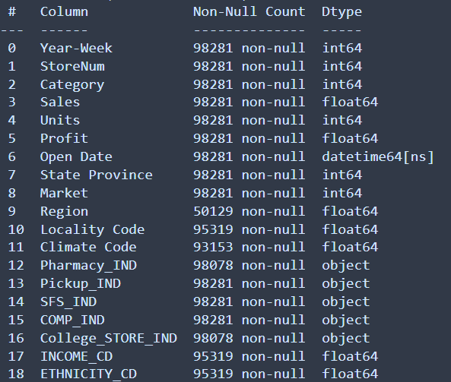
Exploratory data analysis
Data have few columns that contains the null values. Will check in further steps hoe to impute and work on it.
Imputing the continuous data with mean and categorical data with mode.

Slide 12
Data Cleaning
Procedure to prepare data for analysis by elimination or modifying data which is incomplete, incorrect or duplicate.
Data not cleaned by various techniques will hinder the analysis process and deliver inaccurate results
Key Benefits of Data cleaning
Improve ML base model performance
Fair and unbiased decision due to clean data
Reduced over fitting
Enhanced interpretability
With the help of SimpleImputer function, performed imputing and replace the missing values.
Also, dropping the columns like Year-Week, Region and Open Data, that will not required during clustering.

Slide 13
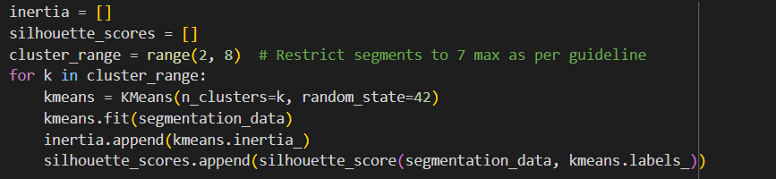
K-means clustering for store segmentation
The elbow method and silhouette scores determine the optimal number of clusters.
The K-Means algorithm groups stores into clusters.

Slide 14
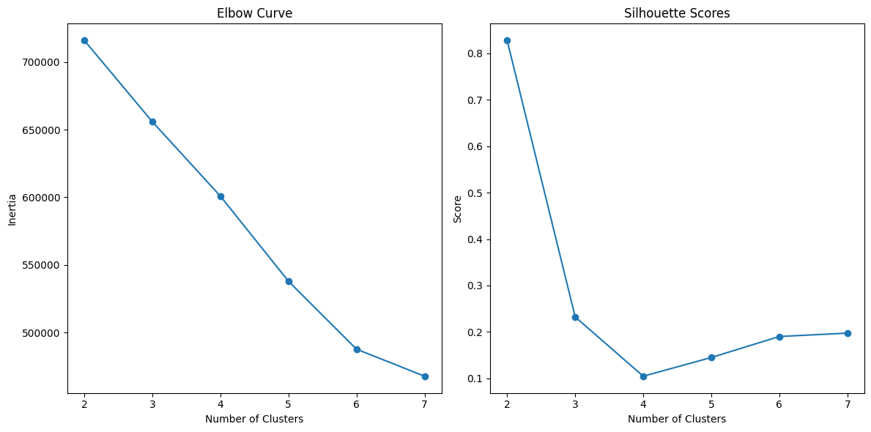
Identifying ideal number of clusters
Best k=4
It balances the Elbow Curve (significant reduction in inertia) and a reasonable silhouette score.
Provides a meaningful tradeoff between simplicity and actionable segmentation without over-complicating the clusters.

Slide 15
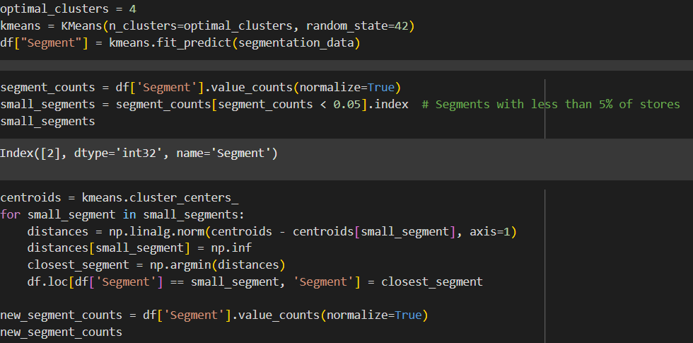
Identifying ideal number of clusters
The cluster 2 only contributes to the less than 5% of the stores, to mitigate the business accordance, the normalization of segments is done.
By taking the centroid of the least cluster value, kept the values of the points into the nearby cluster.
Making this operation, will reducing the one cluster from the data.

Slide 16
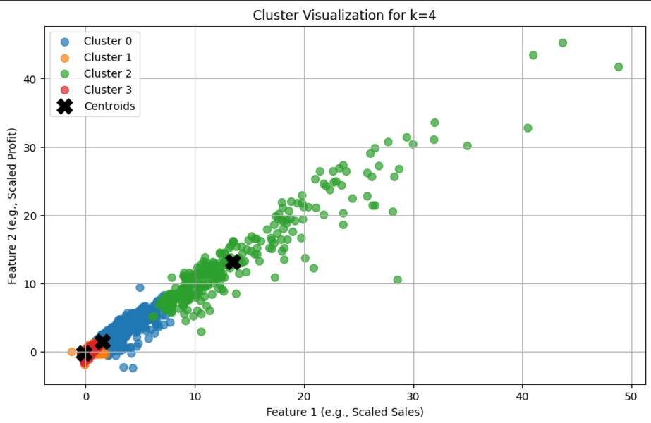
Overview of determining optimum clusters
The cluster is separated the stores with the particular set of color indicating the centroid for the each cluster.

Slide 17
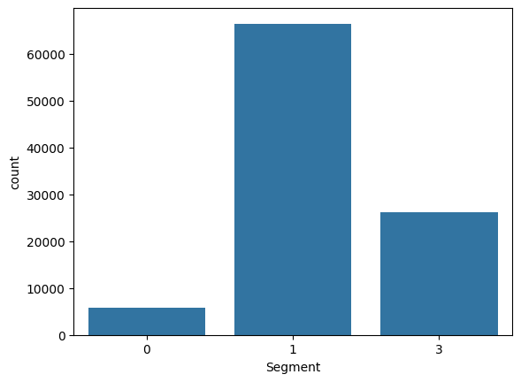
Analyzing clusters characteristics
Each class is shown in the below bar graph. Now, the reduction of cluster is done, will check if the cluster are classified in a best way. For this, well perform Decision tree classifier and see how our cluster segmentation is performing with unknown data.

Slide 18
Analyzing clusters characteristics
Breakdown of the Matrix:
Diagonal Values:
These represent correctly classified instances (True Positives, TP):
1429 for Class 0
19872 for Class 1
7498 for Class 2
Off-Diagonal Values:
These represent misclassifications:
263: Actual Class 0 misclassified as Class 1.
28: Actual Class 0 misclassified as Class 2.
58: Actual Class 1 misclassified as Class 0.
0: Actual Class 1 misclassified as Class 2.
18: Actual Class 2 misclassified as Class 0.
319: Actual Class 2 misclassified as Class 1.
1429 | 263 | 28
58 | 19872 | 0
18 | 319 | 7498

Slide 19
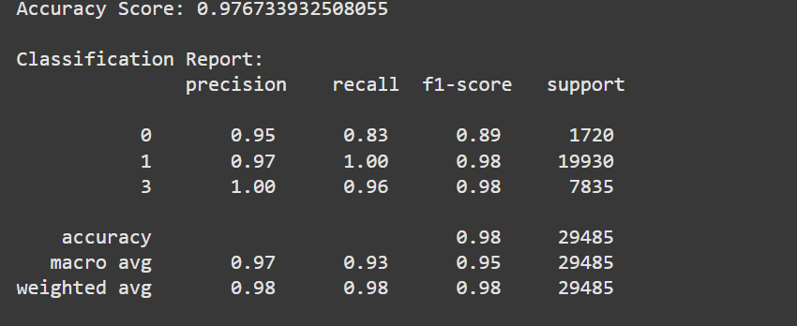
Analyzing clusters characteristics
Voila! It’s looks like the model is shown a good accuracy. Also, the f1 score is showing the good score for cluster.

Slide 20
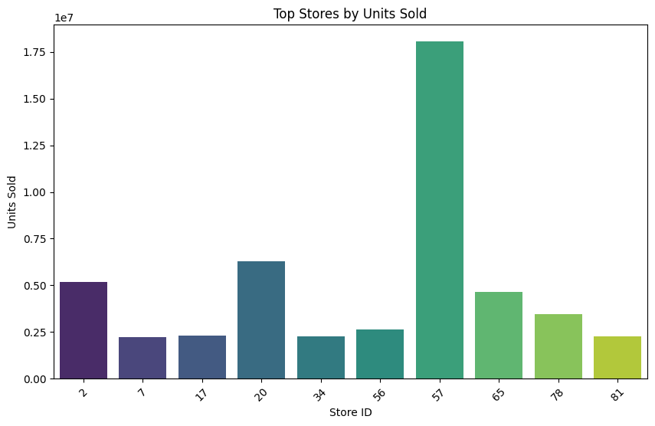
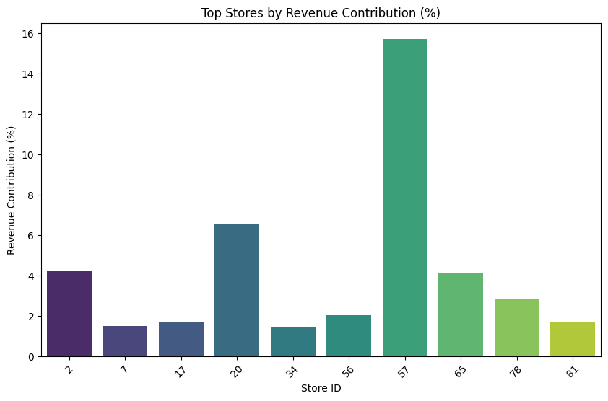
Formulating marketing and pricing strategies for different clusters
Which stores are the most critical drivers of overall revenue and customer engagement?
Ans. Displays top stores by revenue and Units Sold, showing their percentage contribution to overall revenue.

Slide 21
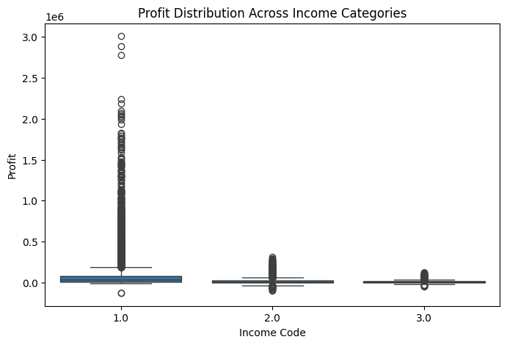
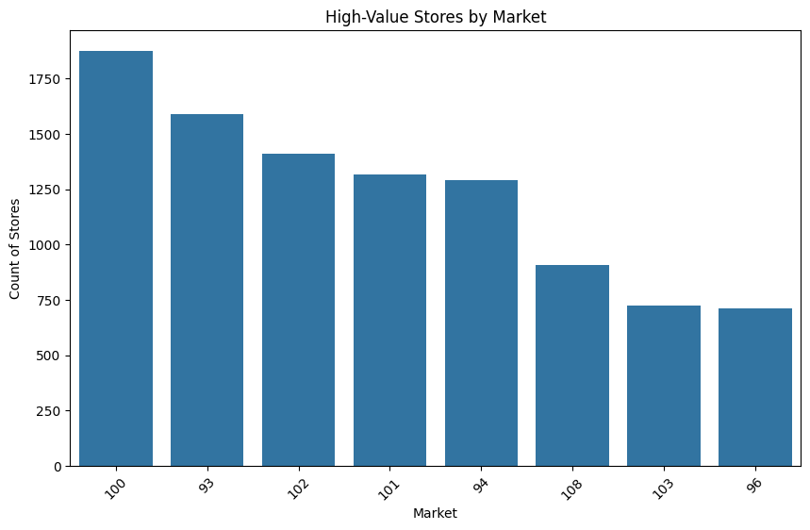
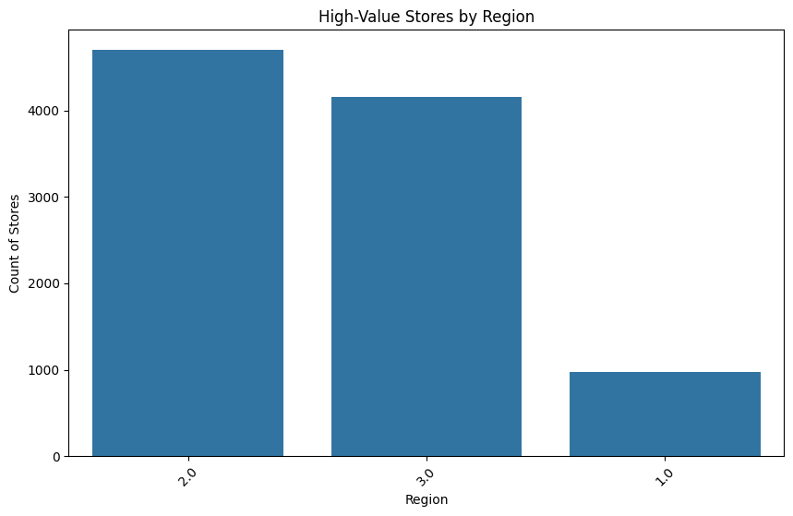
Formulating marketing and pricing strategies for different clusters
2) What are the demographic characteristics of high-value stores that contribute significantly to profitability?
Ans. High-value stores are predominantly located in urban markets. Most high-value stores are in areas with middle-to-high income levels. High-value stores often have pickup facilities and pharmacies.

Slide 22
Formulating marketing and pricing strategies for different clusters
3) What targeted engagement and assortment strategies can be developed for each store cluster to maximize customer satisfaction and drive sales growth?
Segment 1: Largest Cluster
Assortment
Focus on high-demand, essential products across categories.
Offer regional favorites to cater to diverse tastes.
Engagement
Use loyalty programs to maintain broad appeal.
Introduce in-store promotions and discounts to retain footfall.
Marketing
Standardized advertising campaigns for general customer appeal.
Seasonal campaigns (e.g., holidays, vacations) for sales spikes.
Operational Enhancements
Optimize inventory levels using demand forecasting to reduce stock outs.

Slide 23
Formulating marketing and pricing strategies for different clusters
3) What targeted engagement and assortment strategies can be developed for each store cluster to maximize customer satisfaction and drive sales growth?
Segment 3: Mid-Sized Cluster
Assortment
Emphasize a mix of premium and mid-tier products.
Include local and specialty items to cater to specific community preferences.
Engagement
Leverage personalized promotions based on historical purchase data.
Host community events to strengthen the local connection.
Marketing
Focused campaigns highlighting specialty products or local relevance.
Partner with local influencers to promote the store brand.
Operational Enhancements
Encourage online orders and pickup via e-commerce.

Slide 24
Formulating marketing and pricing strategies for different clusters
3) What targeted engagement and assortment strategies can be developed for each store cluster to maximize customer satisfaction and drive sales growth?
Segment 0: Smallest Cluster (niche or high-value)
Assortment
Focus on premium, organic, and specialty products.
Rotate exclusive offerings to create a sense of novelty.
Engagement
Offer VIP loyalty programs or memberships.
Provide personalized customer service, such as store associates trained in high-value product recommendations.
Marketing
Highlight exclusivity and quality in marketing campaigns.
Use targeted social media ads to affluent customers.
Operational Enhancements
Enhance the store ambiance with premium fixtures.
Introduce sampling events for luxury or new products.

Slide 25
Formulating marketing and pricing strategies for different clusters
Count of Ethnicity in Segments
Notes:
Previous slide, we discussed about few hypothesis based on sales and profit. 1. The Small Cluster segment is the one with niche or high value customers. 2. The Large Cluster segment is the one with maximum stores and present across the States. 3. The Mid Size Cluster only present in few states with lesser stores than the Larger one, although the sales and profits are almost same with the larger Cluster segment. Here in the above bar plot, we will first try to understand the Ethnicity in each Segment, by observing the above plot, we can say that the Asian and Hispanic community are missing entirely from the Large Cluster and Mid Size Cluster respectively. Few major areas where tech company might be there, that shown the population of Asian people in general. Here that State code is 64.

Slide 26
Formulating marketing and pricing strategies for different clusters
Notes:
Mostly the economic is driven by the Medium Income customers and majorly they live in metropolitan cities. the states that have these store in Large cluster might me a large cities. Also, we can observe that the niche stores that we found in small cluster comprises of Hispanic communities and the major chuck of people have low income group. This might be because of the two major segments living in parallel in this cluster, we can observe the pattern in next analysis.

Slide 27
Formulating marketing and pricing strategies for different clusters
Count of Climate region in Segments
Notes:
For demographic studies we can simply say that the large number of stores present across the southern and northern region of USA, since all type of weather it contributes to. Strangely, we can see that the Mid Size cluster only contributes toward the climate region where temperature is moderate. Also, we saw early that the code 64 contributes with the Asian communities and our guess is might me a tech place. This can me a place near San Francisco Bay Area of California.

Slide 28
Formulating marketing and pricing strategies for different clusters
Average sales in Segments
Notes:
The Hypothesis is proven in the above plot, where we can easily observe that the niche cluster or smallest once is producing the maximum average sales value with the ratio of number of stores.

Slide 29
Formulating marketing and pricing strategies for different clusters
Average sales in ethnicity among all Segments
Notes:
The communities are well spread and contributing in sales largely. The Asian is not present in high segment although they are in other Income ranges. Here, It might me the places where the high income and medium income customer lives and it also because of that, the low income customer follows in the same proportions.

Slide 30
Formulating marketing and pricing strategies for different clusters
Notes:
Here in the above plot, largely the contribution is observe for each clusters. As we can observe that the large and midsize cluster, the number of stores might be good as compare to small cluster, but the sales percentage contribution is 15% each of the total sales value. Whereas, the small cluster is coming up to 42% of the sales contribution, it is definitely makes this cluster outstanding and performing based on high income customers. Out Hypothesis is proven. H1 is accepted.

Slide 31
Formulating marketing and pricing strategies for different clusters
Segments | Pharma (N) | Pharma (Y) | Percentage of Pharmacy Inside Store per Segment
Large Cluster | 58549 | 7882 | 3%
MidSize Cluster | 25374 | 741 | 8%
Small Cluster | 3721 | 2014 | 35%
Pharmacy Inside Store

Slide 32
Formulating marketing and pricing strategies for different clusters
Segments | N | Y | Percentage of ECOM from Store per Segment
Large Cluster | 2479 | 63952 | 0.962683085
MidSize Cluster | 824 | 25291 | 2.448860808
Small Cluster | 746 | 4989 | 11.15117698
Does Store ship ECOM Orders from Store

Slide 33
Data Integration: Include datasets like GDP growth, unemployment rates, or consumer confidence indexes. Seasonality Adjustments: Decompose time-series data to isolate seasonal components. Lag Features: Add lag variables to capture delayed effects of external factors. Dynamic Segmentation: Use time-sensitive variables to allow clusters to evolve over time
External Factors (ext.)
Created by: Tushar Singh

